Slide 1

C.B. Patel Computer College (CBPCC)
Bachelor of Computer Applications (BCA)
Programme
Project Report
BCA Sem VI
AY 2020-21
ClickToCart: An E-Commerce Based Website
Exam No. | Name of Student
1689 | Shah Vinit
1554 | Desai Kevin
1531 | Agarwal Shrishti
Project Guide by :
Prof. Mohamed Sohel Shaikh

Slide 2
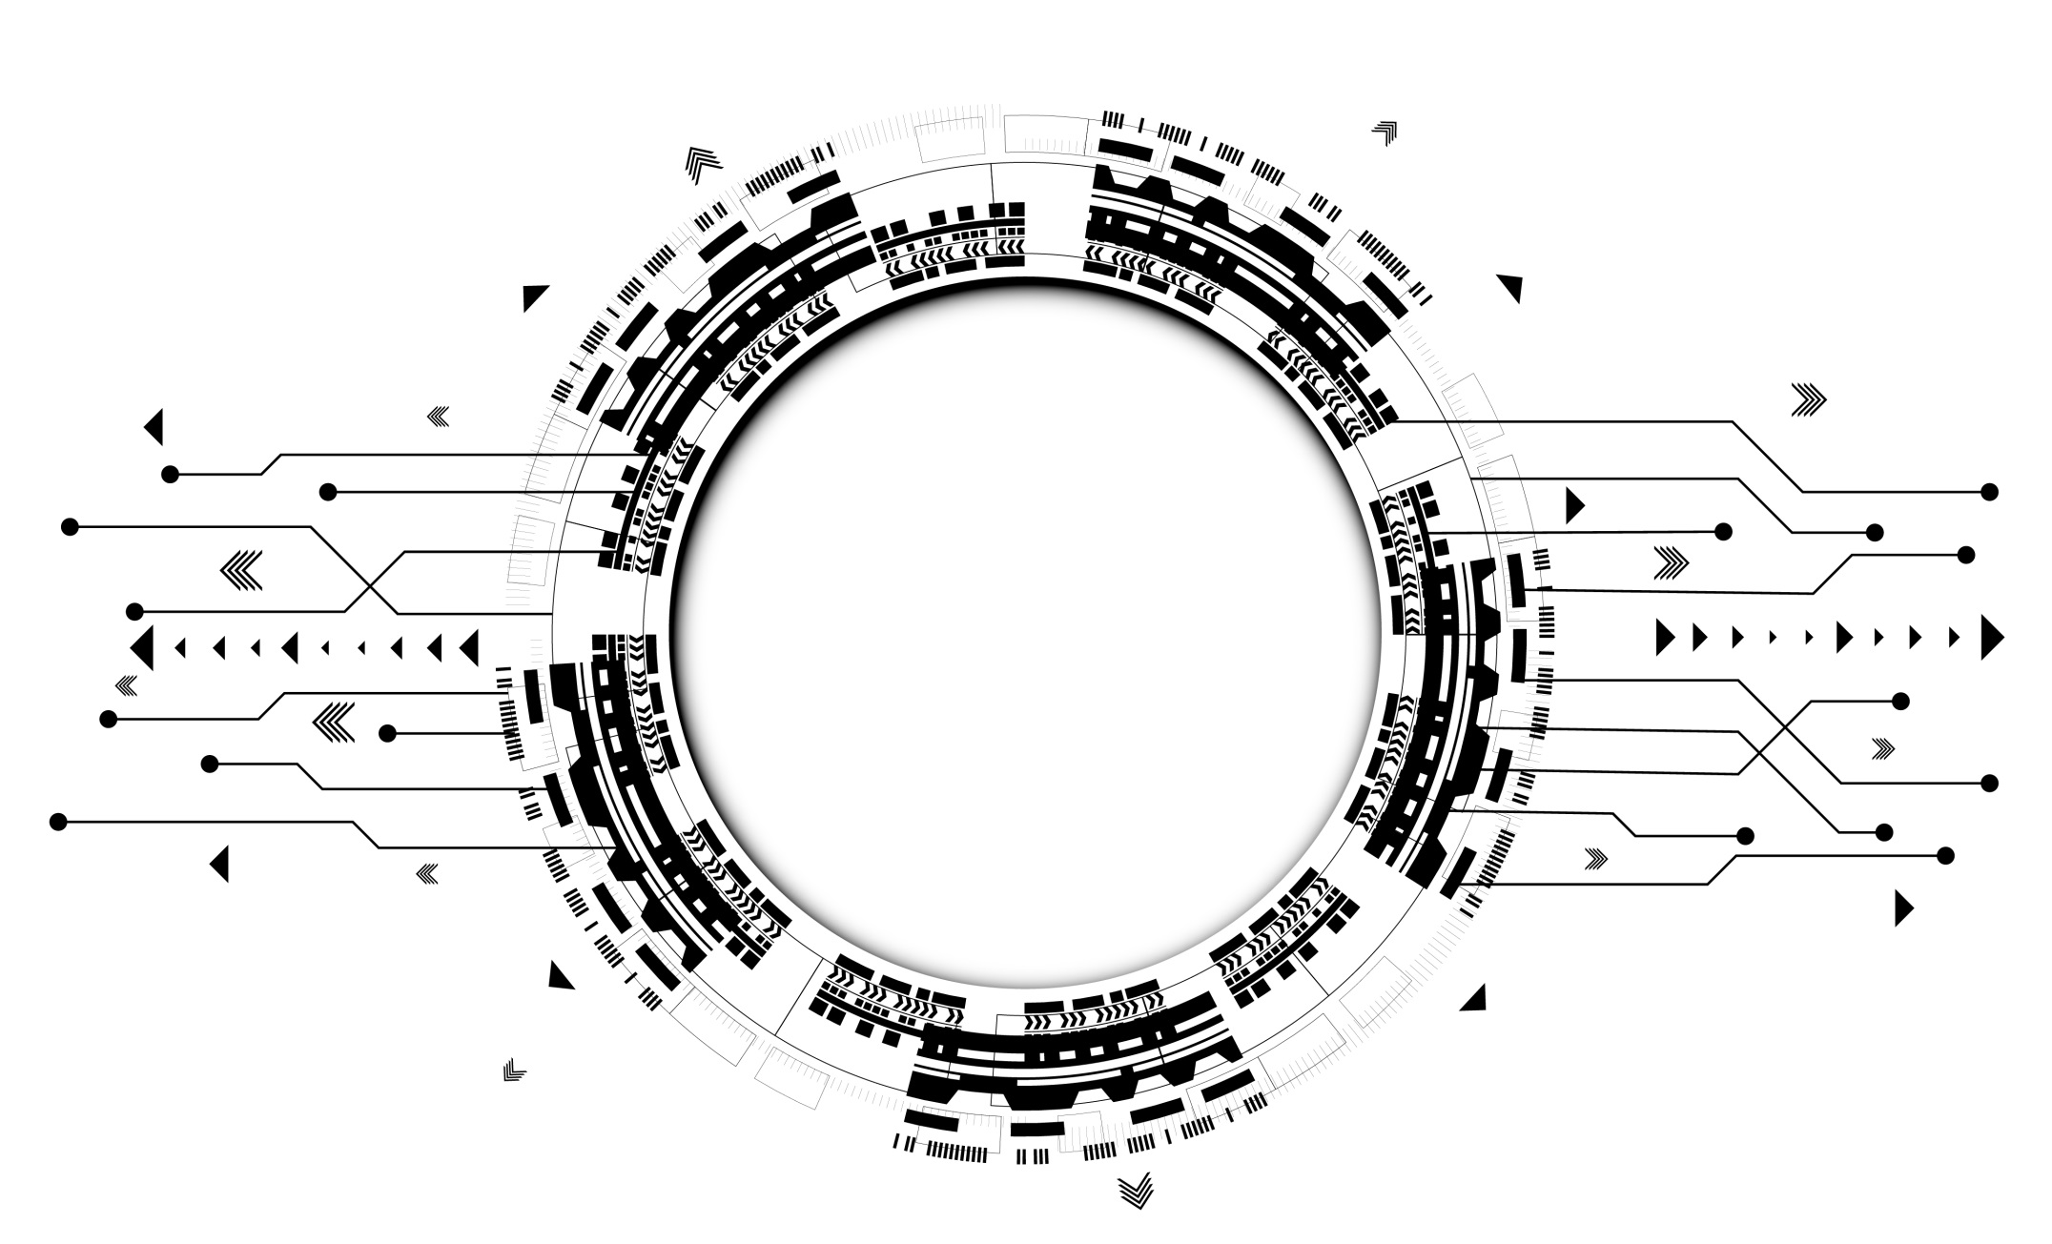
ClickToCart: An E-Commerce Based Website

Slide 3
AGENDA
01
INTRODUCTION
02
TECHNICAL PROFILE
03
HARDWARE AND SOFTWARE REQ
04
MODULES
05
DESIGNING
06
TESTING
07
BIBLOGRAPHY
08
CONCLUSION

Slide 4
intrODUCTIon
ClickToCart is an e-commerce based website that makes the trade for buyers and sellers in few clicks.
This website helps the business personnel (e.g. administrators, managers) to easily manage users and products, apply or remove sales, keep track of orders etc.
In addition, users can search and buy products through secure online transactions and see their order histories later.
The scenario seems pretty basic, and the idea is to keep it that way through backend complex fail-safe design.
1

Slide 5
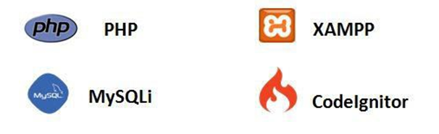

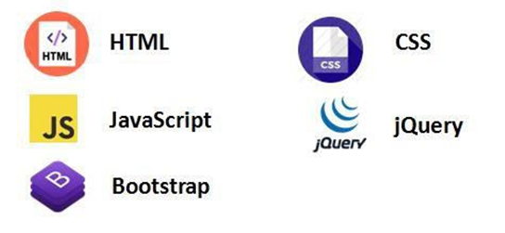
Technical profile
Technology And Server Used
Designing tools
Laravel
2

Slide 6
Technology Details
Below stated technologies are used by us to develop this website.
Hardware :
Processor : Intel(R) Core(TM) i3-5005 @2.00GHz
Memory : 8 GB DDR3
Disk : 256GB SSD
Software :
Operating System : Windows 10 Pro
Front End : HTML, CSS, JavaScript, jQuery, Bootstrap
Backend : PHP, MySQL , Laravel
Input Device : Keyboard , Mouse
Output Device : Monitor
Browser : All Modern Browsers
3

Slide 7
Reason behind it
In recent years, e-commerce has been dominating the world of trades and business. Due to the ease-of accessibility of the internet and microcomputer devices along with the simple manner of usability, it has been a sector where more and more people are merging every day. We wanted to get a little insight of the practical
events and issues related to this sector.
01
Our goal was to build a professional standard project, which would help us to get an idea about how things work in real world (i.e. Website development firms). Working with Laravel has enabled us to become a little familiar to such kind of a workflow.
02
4

Slide 8
modules
ADMIN
ORDERS
PURCHASE
CONTACT US
USER ROLES
RETURN ORDERS
ALL PRODUCTS
REPORTS
5

Slide 9


ADMIN WORK FLOW
1
3
MANAGE
ORDER
ADMIN LOGIN
2
4
MANAGE
SEO SETTINGS
MANAGE
PRODUCT
8
6
MANAGE
SUB-ADMINS
MANAGE REPORTS
7
MANAGE
RETURN ORDER
5
MANAGE BLOGS
6

Slide 10
USER WORK FLOW
1
3
VIEW
ORDERS
USER LOGIN
2
4
TRACK ORDERS
PURCHASE
PRODUCT
8
6
EDIT PROFILE
USER LOGOUT
7
CHANGE PASSWORD
5
RETURN ORDERS
6

Slide 11
DESIGNING
It includes following areas.
Class Diagram
Use Case Diagram
Activity Diagram
Database Design
User Interface
7

Slide 12
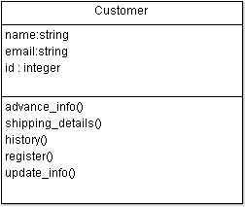
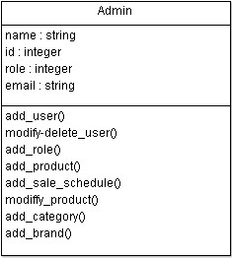

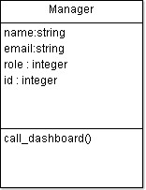
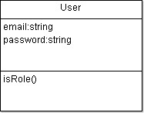
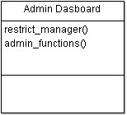
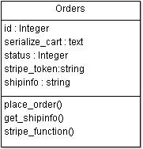
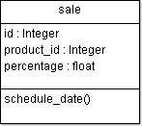
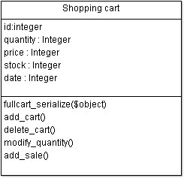
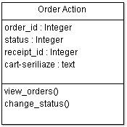
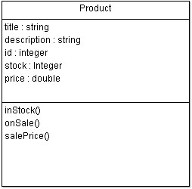
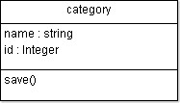
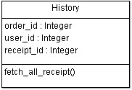
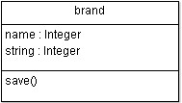
CLASS diagram
Application Class diagram .
8

Slide 13
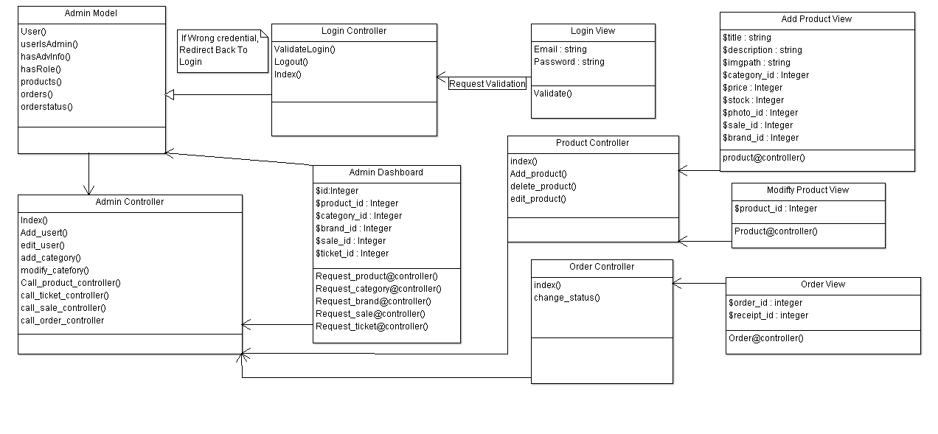
CLASS diagram
Class Diagram for the Admin .
8

Slide 14
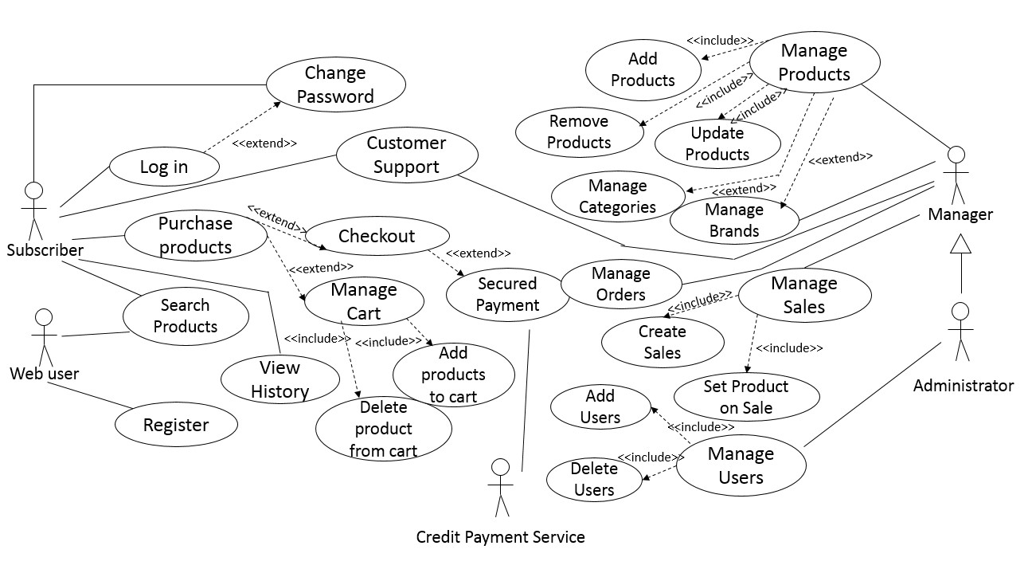
USE CASE DIAGRAM
15

Slide 15
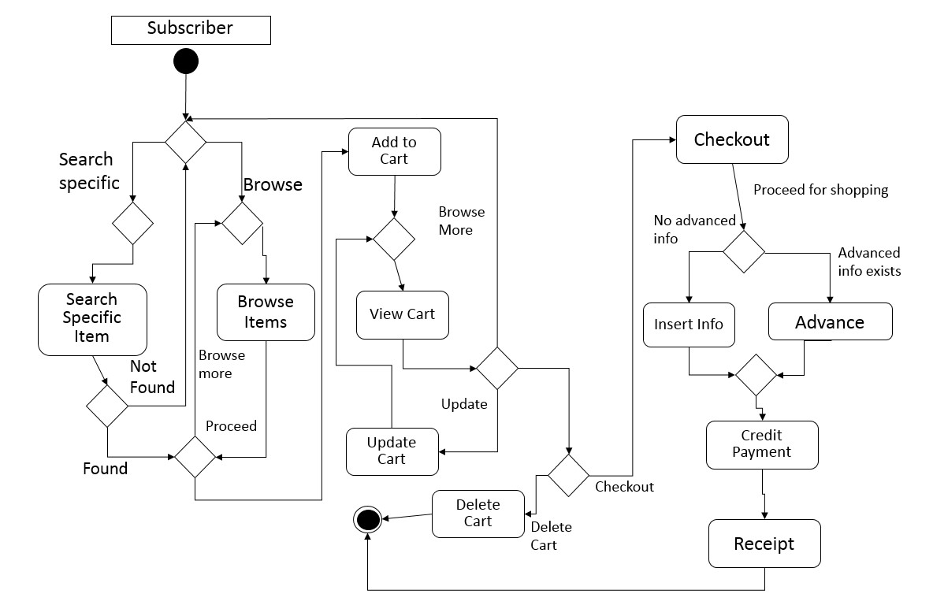
ACTIVITY DIAGRAM
16

Slide 16
DATABASE
Following tables are used:
Sr No | Table name
1 | Admin
2 | Brands
3 | Categories
4 | Cities
5 | Colours
6 | Contact
7 | Countries
8 | Coupons
9 | Order
10 | Newsletter
11 | Password resets
12 | Order_details
13 | Post
14 | Post_category
15 | Products
16 | SEO
17 | Settings
18 | Shipping
19 | Site settings
20 | Sizes
21 | Subcategories
22 | Users
23 | Wishlist
17

Slide 17
DATABASE
1. Admin
Column Name | Data Type | Size | Null
Id | bigint | 20 | No
Name | varchar | 191 | No
Phone | varchar | 191 | No
Email | varchar | 191 | No
Avatar | varchar | 500 | No
Email_verified_at | timestamp |  | No
Password | varchar | 191 | No
Remember_token | varchar | 100 | Yes
Reports | varchar | 255 | No
Categories | varchar | 255 | No
Products | varchar | 255 | No
Orders | varchar | 255 | No
Return_orders | varchar | 255 | No
Coupons | Varchar | 255 | No
blogs | varchar | 255 | No
Note: For presentation, details of few tables are shown here. To know to full DB click here(pg: 51)
18

Slide 18
DATABASE
2. User
Column Name | Data Type | Size | Null
Id | bigint | 20 | No
Name | Varchar | 191 | No
Phone | Varchar | 191 | Yes
Email | varchar | 191 | No
Avatar | varchar | 255 | Yes
Provider | varchar | 255 | Yes
Provider_id | varchar | 255 | Yes
Email_verified_at | Timestamp | 191 | Yes
Password | varchar | 191 | Yes
Remember_token | varchar | 100 | Yes
Created_at | Timestamp |  | Yes
Updated_at | Timestamp |  | Yes
19

Slide 19
DATABASE
3. Products
Column Name | Data Type | Size | Null
Id | bigint | 20 | No
Category_id | Int | 11 | No
Subcategory_id | Int | 11 | Yes
Brand_id | Int | 11 | Yes
Product_name | varchar | 191 | No
Product_code | varchar | 191 | No
Product_quantity | varchar | 191 | No
Product_details | Longblob |  | Yes
Product_color | varchar | 191 | No
Product_size | varchar | 191 | No
Selling_price | Int | 191 | No
Discount_price | Int | 191 | Yes
Video_link | varchar | 191 | Yes
Main_slider | Int | 11 | Yes
Hot_deal | Int | 11 | Yes
Best_rated | Int | 11 | Yes
Mid_slider | Int | 11 | Yes
Hot_new | Int | 11 | Yes
Buyone_getone | Int | 11 | Yes
Trend | Int | 11 | Yes
Image_one | Varchar | 191 | Yes
Image_two | Varchar | 191 | Yes
Image_three | Varchar | 191 | Yes
Status | Int | 11 | Yes
Created_at | Timestamp |  | Yes
Updated_at | Timestamp |  | Yes
20

Slide 20
DATABASE
4. SEO
Column Name | Data Type | Size | Null
Id | Bigint | 20 | No
Meta_title | Int | 11 | Yes
Meta_author | Int | 11 | Yes
Meta_tag | Varchar | 191 | Yes
Meta_description | Text |  | Yes
Google_analytics | Text |  | Yes
Bing_analytics | Text |  | Yes
Created_at | Timestamp |  | Yes
Updated_at | Timestamp |  | Yes
21

Slide 21
DATABASE
5. Site settings
Column Name | Data Type | Size | Null
Id | Bigint | 20 | No
Vat | Varchar | 191 | Yes
Shipping_charge | Varchar | 191 | Yes
Shopname | Varchar | 191 | Yes
Email | Varchar | 191 | Yes
Phone | varchar | 191 | Yes
Address | Varchar | 191 | Yes
Logo | Varchar | 191 | Yes
Created_at | Timestamp |  | Yes
Updated_at | Timestamp |  | Yes
22

Slide 22
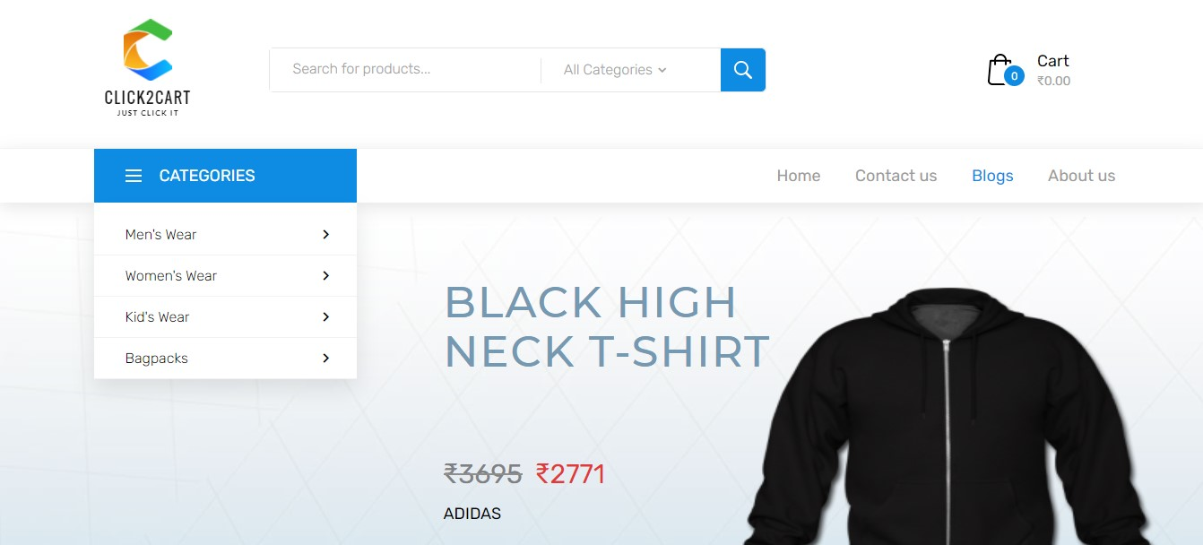
USER INTERFACE
01
ClickToCart website link
02
Move to Documentation
27

Slide 23
TESTING
01
UNIT TESTING
02
NAVIGATIONAL TESTING
03
FUNCTIONAL TESTING
04
ENVIRONMENTAL TESTING
28

Slide 24
UNIT TESTING
Name | Admin Login
Description | This test case will check whether email & password is valid or not. It not then it will allow the user will login
Input Data | System allows login Define blank Email / Mob No. &Password Valid Email / Mob No. & Blank Password Valid Email / Mob No. but Wrong Password Wrong Email / Mob No. but Valid Password Wrong Email / Mob No. &Password
Output | System allows login û Email / Mob No. must required û Password must required û System prompt error that email / Mob No. is not valid û System prompt error that enter email / Mob No. & password
Actual Output | System allows login
29

Slide 25
NAVIGATIONAL TESTING
Link | Expected Page | Result Page
Login | Admin Login | Admin Login
Dashboard | Dashboard Page | Dashboard Page
Manage User | Manage Users | Manage Users
Purchase | Purchase Products | Purchase Products
Sales | Sales Products | Sales Products
All Orders | Manage Orders | Manage Orders
All Products | Manage Products | Manage Products
All Messages | Manage Messages | Manage Messages
Return Orders | Manage Return Orders | Manage Return Orders
Reports | Manage Reports | Manage Reports
Daily Sales Report | Manage Daily Sales | Manage Daily Sales
Product Quantity Report | Manage Product Quantity | Manage Product Quantity
Coupons | Manage Coupons | Manage Coupons
Sales Report | Manage Monthly Sales | Manage Monthly Sales
Contact messages | Manage Contact messages | Manage Contact messages
User roles | Manage User roles | Manage User roles
Site settings | Manage Site settings | Manage Site settings
30

Slide 26
FUNCTIONAL TESTING
    Functional Testing is a type of system testing where, the system is tested against the functional requirements/specifications.
    User Registration: Process has been properly working and all fields are validated through various validation checks.
    Login & password validation process has been co-operated properly.
31

Slide 27
ENVIRONMENTAL TESTING
    This is a level of system testing where complete & integrated system is tested.
    The purpose of this test is to evaluate the systems compliance with the specified requirements.
    The process of testing an integrated system to verify that it meets specified requirements.
32

Slide 28
Conclusion
In the project we explored and demonstrated a few advanced, user-friendly features to carry out the regular tasks.
Working on this project, we came to a better understanding of how ecommerce and engineering techniques can work hand in hand to bring more advancement in the sector.
We hope people interested in this sector would get a clear view on the workflow of these kind of businesses and take that extra step to explore the sector for the purpose of improvement.
33

Slide 29
Bibliography
https://www.w3schools.com
https://en.wikipedia.org/wiki/Laravel/
https://laracasts.com/
http://stackoverflow.com/
http://www.laravel.io/
http://www.tutorialspoint.com/laravel/
http://www.youtube.com/
http://bootsnipp.com/
https://en.wikipedia.org/wiki/Design_specification/
http://www.getbootstrap.com/
https://github.com/thekordy/ticketit/
https://github.com/GrahamCampbell/Laravel-Throttle
https://stripe.com/
34

Slide 30


